Slide 1
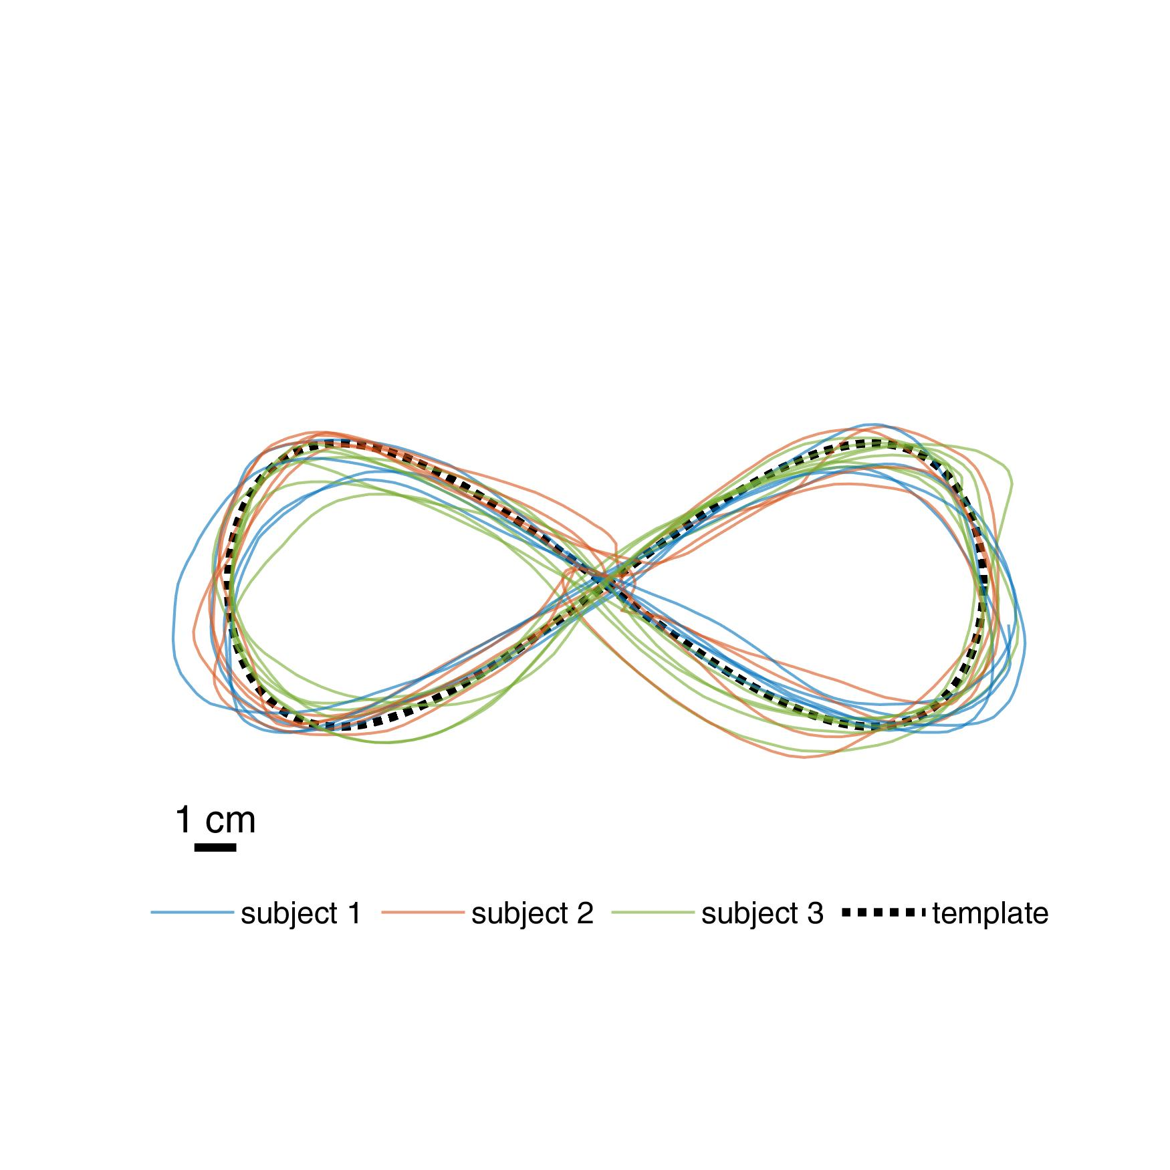
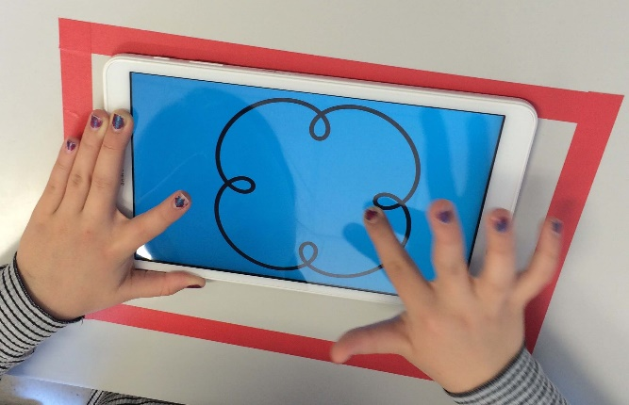
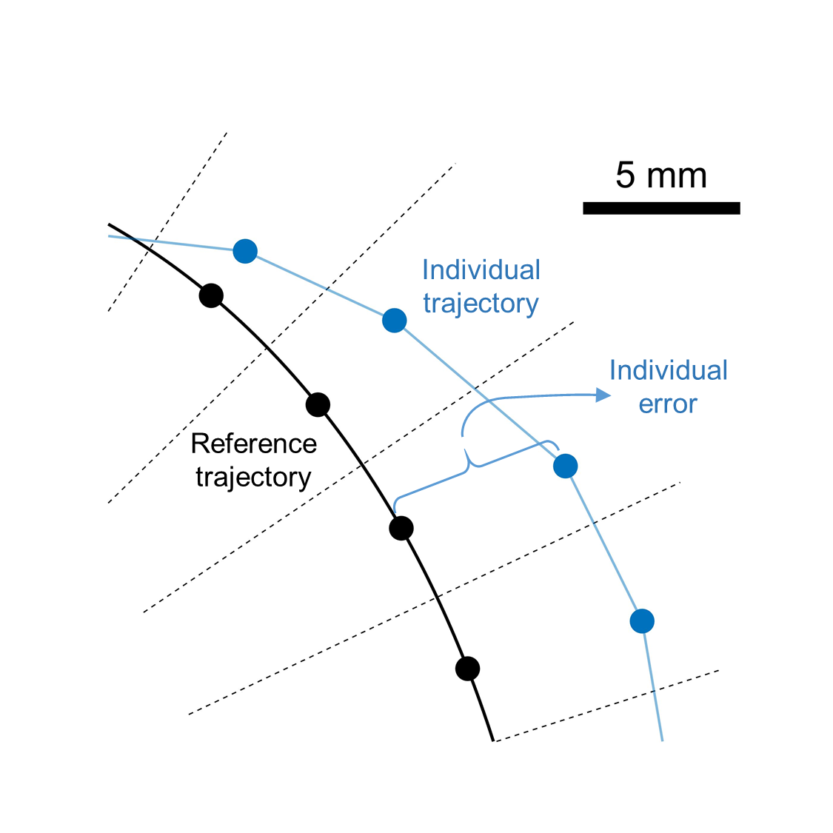
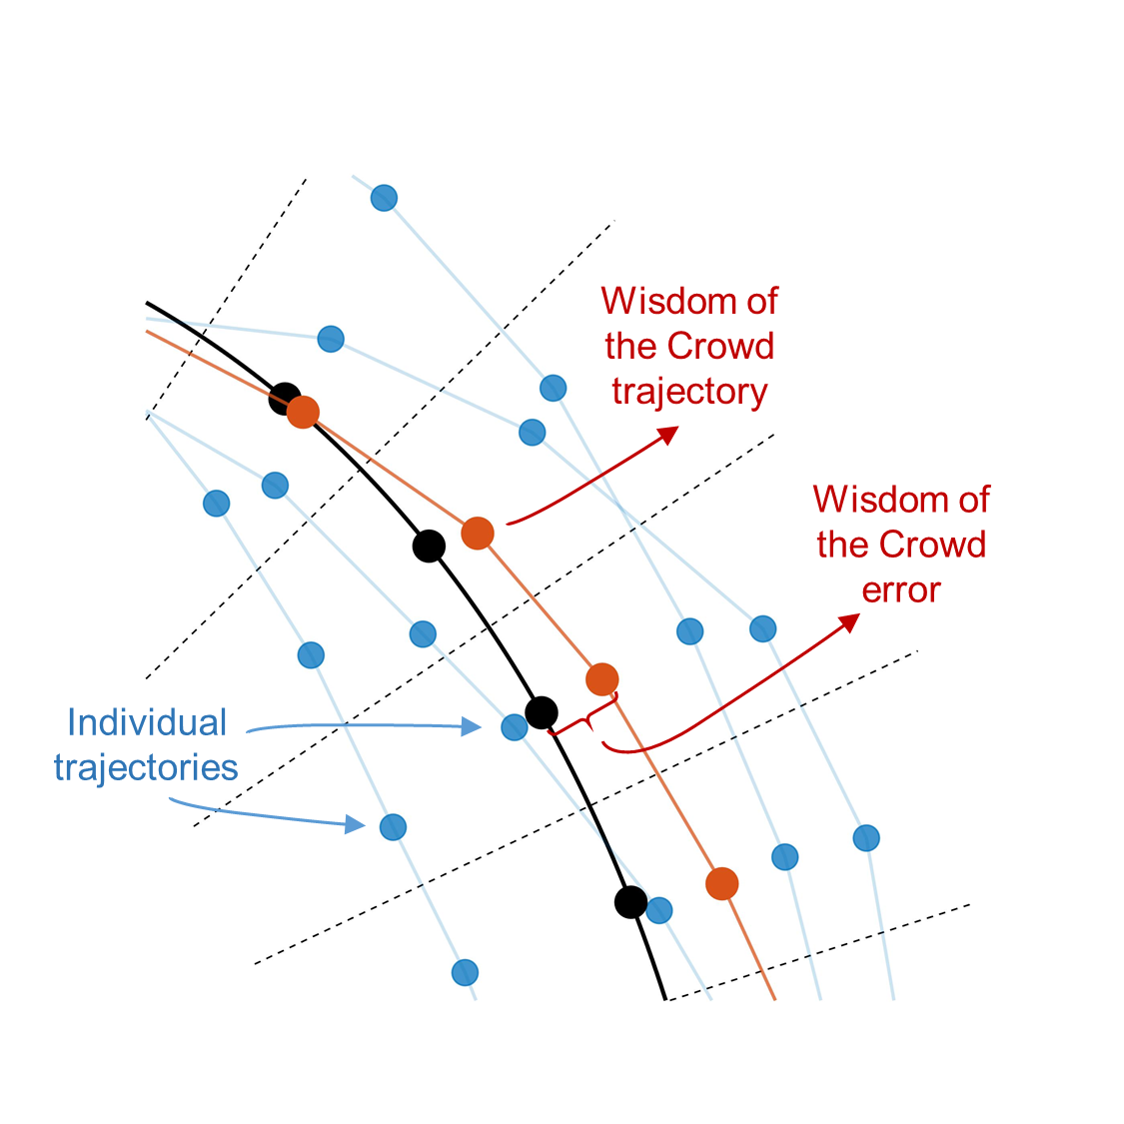
A
B
NOT YET CROPPED!
C
Computation of aggregate trajectory (Wisdom of the Crowd) and its errors
Computation of individual errors

Slide 2
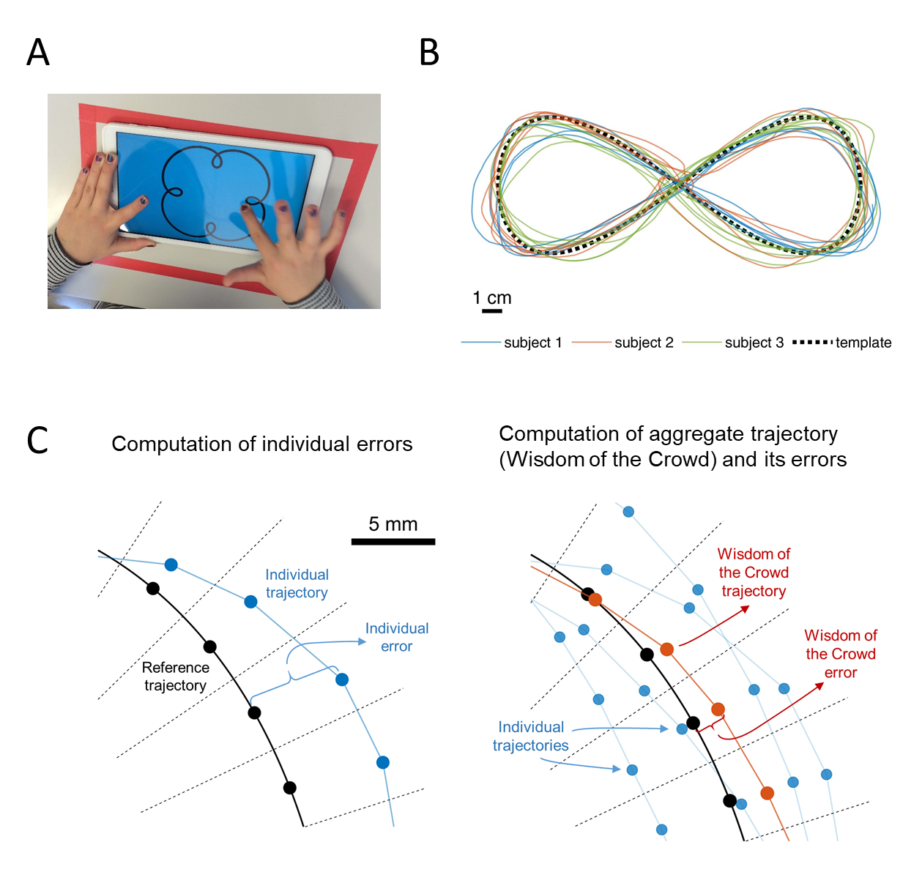
CROPPED!

